Slide 1
Data Robot

Slide 2
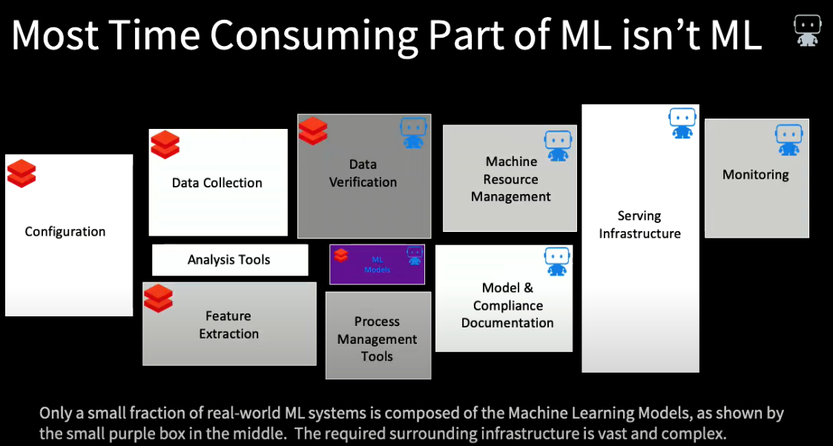

Slide 3
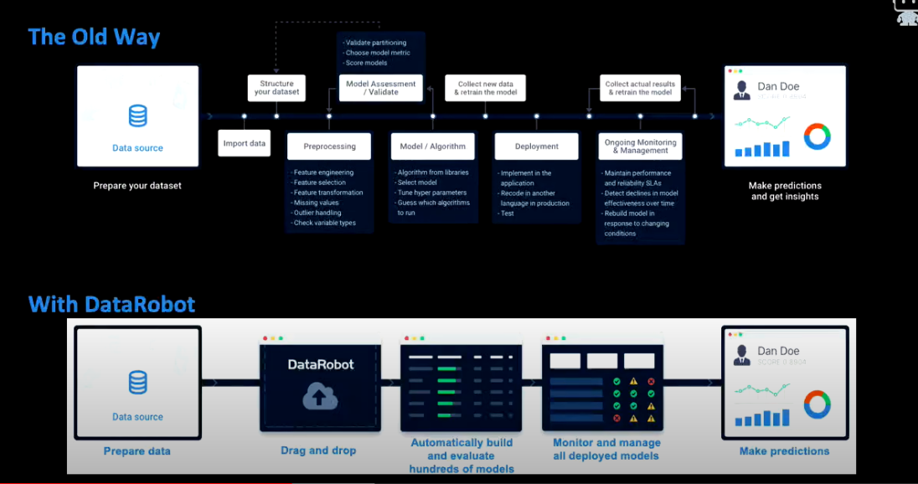
Tradional ML approach vs. DataRobot

Slide 4
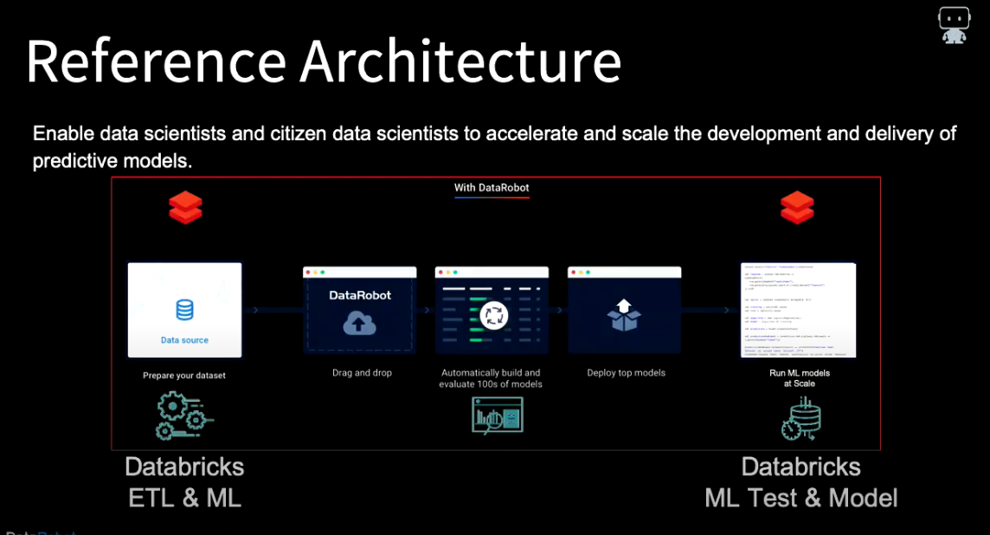

Slide 5
